Slide 1
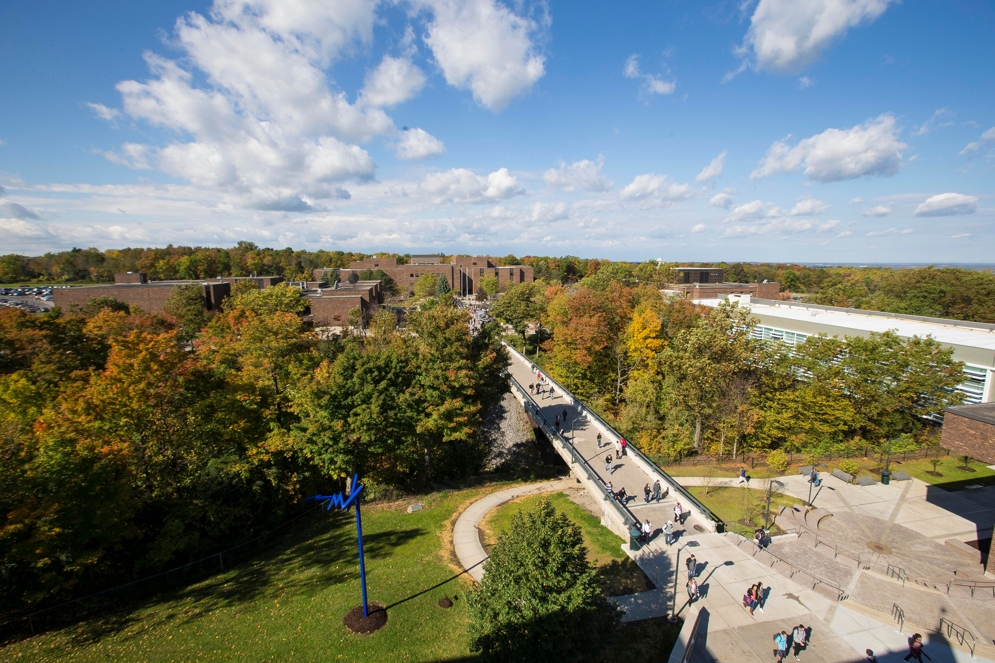


2023-2028 Strategy Plan Update
Board of Trustees
May 2, 2025
Agatha Awuah, Ph.D.
Office of Institutional Planning, Assessment & Research

Slide 2
Brief Overview

Slide 3
Strategic Planning Process
Fall 2022
Creation of the Strategic Planning Task Force
Request for Proposals sent to consultants
Spring 2023
Dr. Nicole Alioto- Alla Breve Educational was selected
Work began
Fall 2023
Strategic Planning Task Force Completes its work
Board approves at its November 2023 meeting
Strategic Plan shared with College Leadership Council and other Campus stakeholders and Board of Trustees.

Slide 4
STRATEGIC THEMES
PERSISTENCE
ACADEMIC SUCCESS
STUDENT EXPERIENCE
(STRATEGIC) COMMUNICATION

Slide 5
2023-28 Strategic Plan Overview
3 Strategic Priorities
Academic Programs & Course Modality
Teaching Innovation & Excellence
Academic Support Services
8 Key Performance Indicators
Persistence, Retention & Graduation
Closing Achievement Gaps
Credit Accumulation and milestone
Goal # 1
Academic Success
4 Strategic Priorities
Student-Centered systems and procedures
Diversity, Equity & Inclusion
Student Belonging, Engagement & Wellbeing
Support Systems to address non-cognitive barriers to success
4 Key Performance Indicators
Recommendation of OCC to High School Students
Diversity, Equity & Inclusion as core values of OCC’s mission
Sense of Belonging at OCC
Satisfaction with Quality of Education at OCC
Goal # 2
Student Experience
5 Strategic Priorities
Consistent & well-coordinated communication messages
Strategic Communication interventions
Employees understanding of their contribution towards student success
Stakeholders mechanism to share ideas
Recognition of OCC brand
6 Key Performance Indicators
Complete audit of College communications
Practice of open and ethical communication
Student competencies
Centrality of Students’ needs
Information sharing
Stakeholders perception of OCC
Goal # 3
Communication

Slide 6

2023-28 Strategic Plan Summary
3 GOALS
12 STRATEGIC PRIORITIES
18 KEY PERFORMANCE INDICATORS

Slide 7
Strategic Planning In Brief
Mission
Vision
Core Values
Goals
Strategies
Key Performance Indicators
Initiatives
Initiative Teams or Work Groups
Needed to operationalize the Strategic Plan

Slide 8
Planning and Goal Alignment
Strategic Plan
Divisional Annual Plans (VP/SVP)
Functional Area Annual Operational Plans
4DX to help with Execution

Slide 9
Planning and Goal Alignment
Templates
President asked IPAR to develop a template for distribution to all VPs/SVPs and their functional areas including the President’s Office
The Template was to include dropdowns for 4DX WIGS
Operational Plans
President sent out the template together with KPIs to Campus Community on October 22, 2024, with all Operations due to VPs/SVPs on November 22, 2024
VP submitted all Functional Area Operational Plans to IPAR
Executive Council
Executive Council Retreat on February 24, 2025

Slide 10
Sample Operational Plan
Division/Department Operational Plan
Department Name | IPAR
Strategic Plan Goal | Strategic Priorities | Key Performance Indicators (KPI) | Desired Outcome | Actions/Tactics | Milestones | Responsibility/ Accountability | Resources Needed | Timeline | 4DX Team WIG? | 4DX WIG/Sub-WIG (Select from Drop Down List)
What goal of the Strategic Plan does this align with most closely? | What strategic priorities of the Strategic Plan does this align with most closely? | What Strategic Plan KPI(s) does this align with? | What is the desired Outcome? | How does the department plan on achieving the desired outcome? | What milestones (including the date(s) for the milestones) will signal success? | Who will be responsible for achieving this goal ? | How much is the outcome expected to cost? (Budget dollars only need to be listed if it is beyond the department's normal operating budget) | When is the desired outcome expected to be achieved by? | Is this your 4DX Team WIG (Y/N) | Which College WIG/Sub-WIG is this most closely related?
Select from Drop Down List | Select from Drop Down List | Select from Drop Down List |  |  |  |  |  |  |  | Select from Drop Down List
Goal 1: Help students achieve their educational and career goals through responsive academic experiences, innovative teaching strategies, and exemplary learning support services. | Strategic Priority 1.1: Ensure that academic programs and course modalities meet student demand and foster student success. | 1.1.1 Fall to Spring Persistence | Provide campus leaders with better access to data related to key performance indicators | Develop and maintain dashboards to support tracking 4DX WIG/Sub-WIG metrics and Strategic Plan KPIs. | Develop updated dashboard plan by December 16, 2024; dashboards 50% complete by April 15, 2025; dashboards 100 % Complete by August 15, 2025 | Dir. Of Data Insights and Visualization | Existing Resources: Power BI Pro Licensing, Power Automate licensing, SQL access to data warehouse, access to automated Informer reports, SIRIS data files | 100 % Complete by August 15, 2025 | No | Sub-WIG: Increase fall to Spring persistence rate 2% annually from 77.5% to 79.5% August 31, 2025
Goal 3: Ensure communication systems are consistent, transparent, and designed to promote student success. | Strategic Priority 3.1: Ensure communication messages and tactics are consistent, well-coordinated, and focused on promoting academic success and a positive student experience. | 3.4.1 Information is shared within this institution | Increase data literacy among key campus data users | Develop a data glossary of terms; Develop how-to documentation on Power BI dashboards; Conduct trainings with key data users | Data Glossary by 5/31/2025 how-to documentation developed by 5/31/25; trainings completed by 5/31/25 | IPAR team | Existing Resources | 100 % Complete by May 31, 2025 | Yes | Primary WIG: Increase 3 year graduation rate (1st time full-time degree seeking ) 1% annually from 25% to 26% by August 31, 2025
Goal 3: Ensure communication systems are consistent, transparent, and designed to promote student success. | Strategic Priority 3.3: Improve employees' understanding of how their area contributes toward overall college goals. | 3.3.1 Percentage of employees who report the extent to which students’ needs are central to what they do | Enhance the capacity of the office by identifying and implementing opportunities for 1) enhancing skills through professional development, 2) increasing operational efficiency through automation or improved processes, and/or 3) improving quality assurance procedures | Each member of the IPAR team will identify and implement one continuous improvement action related to professional development, increasing operational efficiency, or improving quality assurance procedures. | Identify continuous improvement actions by February 14, 2025 100 % Complete by August 15, 2025 | IPAR team | Existing Resources | 100 % Complete by August 15, 2025 | No | Primary WIG: Increase 3 year graduation rate (1st time full-time degree seeking ) 1% annually from 25% to 26% by August 31, 2025

Slide 11
Sample Operational Plan
Division/Department Operational Plan
Department Name | Facilities
Division | Financial and Management Services
Strategic Plan Goal | Strategic Priorities | Key Performance Indicators (KPI) | Desired Outcome | Actions/Tactics | Milestones | Responsibility/ Accountability | Resources Needed | Timeline | 4DX Team WIG? | 4DX WIG/Sub-WIG (Select from Drop Down List)
What goal of the Strategic Plan does this align with most closely? | What strategic priorities of the Strategic Plan does this align with most closely? | What Strategic Plan KPI(s) does this align with? | What is the desired Outcome? | How does the department plan on achieving the desired outcome? | What milestones (including the date(s) for the milestones) will signal success? | Who will be responsible for achieving this goal ? | How much is the outcome expected to cost? (Budget dollars only need to be listed if it is beyond the department's normal operating budget) | When is the desired outcome expected to be achieved by? | Is this your 4DX Team WIG (Y/N) | Which College WIG/Sub-WIG is this most closely related?
Select from Drop Down List | Select from Drop Down List | Select from Drop Down List |  |  |  |  |  |  |  | Select from Drop Down List
Goal 3: Ensure communication systems are consistent, transparent, and designed to promote student success. | Strategic Priority 3.3: Improve employees' understanding of how their area contributes toward overall college goals. | 3.4.1 Information is shared within this institution | Improve building maintenance through increased communication between facilities departments | Custodians will identify non-emergency issues in campus buildings and issue work orders for the Building Services Dept to address the issues. | Each week the custodial staff will identify five maintenance issues per "zone". | Facilities Custodial Assistant Director | Existing staff and operating budget | Ongoing. Five issues identified per week. | Yes | Sub-WIG: Increase fall to Spring persistence rate 2% annually from 77.5% to 79.5% August 31, 2025
Goal 2: Foster a student-centered and equitable campus experience where all students feel welcomed, valued, connected, and empowered to succeed. | Strategic Priority 2.3: Foster student belonging, engagement, and wellbeing. | 2.4.2 The percentage of students who report the process by which their voice can be heard is effective | Improve living learning environment in the residence halls by addressing building maintenance issues | Building Services will complete student work requests in the residence halls in a more timely manner; from an average of 7 days to 5 days from request to completion. | By February, the request completion time will be reduced to an average 6 days | Building Services - Director | Existing staff and operating budget | By 8/15/2025, the request completion time will be reduced to an average 5 days | Yes | Sub-WIG: Increase fall to Spring persistence rate 2% annually from 77.5% to 79.5% August 31, 2025
Goal 3: Ensure communication systems are consistent, transparent, and designed to promote student success. | Strategic Priority 3.1: Ensure communication messages and tactics are consistent, well-coordinated, and focused on promoting academic success and a positive student experience. | 3.4.1 Information is shared within this institution | Increase campus stakeholder communication related to facilities projects | Facilities project managers will contact at least one campus stakeholder each week about current facilities projects | By February, facilities project managers will engage with at least three campus stakeholders per week | Facilities Project Team - Assistant Director and Project Managers | Existing staff and operating budget | By 8/15/2025, facilities project managers will engage with at least three campus stakeholders per week | Yes | Sub-WIG: Increase fall to Spring persistence rate 2% annually from 77.5% to 79.5% August 31, 2025
Goal 2: Foster a student-centered and equitable campus experience where all students feel welcomed, valued, connected, and empowered to succeed. | Strategic Priority 2.3: Foster student belonging, engagement, and wellbeing. | 2.3.1 The percentage of students who feel a great sense of belonging at OCC | Increase the quality of Campus Conditions for Student Living and Attendance by addressing maintenance issues | Grounds will complete 80% of work order requests within 5 days. | By February, 70 % of the requests will be completed within 5 days | Grounds Maintenance and Fleet Services Coordinator | Existing staff and operating budget | By 8/15/2025, 80% of work order requests will be completed within 5 days | Yes | Sub-WIG: Increase fall to Spring persistence rate 2% annually from 77.5% to 79.5% August 31, 2025

Slide 12
Fall 2024 Update
ACADEMIC SUCCESS
GOAL # 1

Slide 13
Fall-Spring Persistence

Slide 14
Fall- Fall Retention

Slide 15
3-Year Graduation Rate

Slide 16
Decrease Achievement Gap in Fall-to-Fall Retention Rates of Underrepresented Minorities
Retention Rates
Achievement Gap

Slide 17
Decrease Achievement Gap in Fall-Fall-Retention of First-Generation Students
Retention Rates
Achievement Gap

Slide 18
Decrease Achievement Gap in 3-year graduation rate of underrepresented minorities
3-year Graduation Rates
Achievement Gap

Slide 19
Decrease Achievement Gap in 3-year graduation rate of First Generation Students
3-year Graduation Rates
Achievement Gap

Slide 20
Percentage of first-time full-time degree-seeking entering cohort who successfully completed 24 or more college credits in their first year of enrollment

Slide 21
GOAL # 2
STUDENT EXPERIENCE

Slide 22
How likely is it that you would recommend this college to a friend or peer (1= not at all likely and 10= being extremely likely)? (Very likely >=7)

Slide 23
Indicate your level of satisfaction with racial harmony at this college (Satisfied/Very Satisfied

Slide 24
Indicate your level of satisfaction with your sense of belonging at this college (Satisfied/Very satisfied

Slide 25
Indicate your level of satisfaction with the overall quality of instruction at this college (satisfied/Very satisfied)

Slide 26
GOAL # 3
COMMUNICATION

Slide 27
Complete audit of College communications to students and employees will demonstrate consistence and transparency
N/A

Slide 28
Open and ethical communication is practiced at this institution

Slide 29
Students’ competencies are enhanced

Slide 30
Percentage of employees who report the extent to which students’ needs are central to what they do

Slide 31
Information is shared within this institution

Slide 32
External stakeholders’ perception of OCC based on RMS Brand Survey Questions (score out of 5)

Slide 33
What’s Next
  Initiatives update would be collected and reported out during the Spring 2025 Strategic Plan Update

Slide 34
QUESTIONS?

Slide 35




THANK YOU
4585 W. Seneca Turnpike, Syracuse, NY 13215
45
315-498-2500
ipar@sunyocc.edu

